Slide 1
The Shell Method

Slide 2
Objectives
Find the volume of a solid of revolution using the shell method.
Compare the uses of the disk method and the shell method.

Slide 3
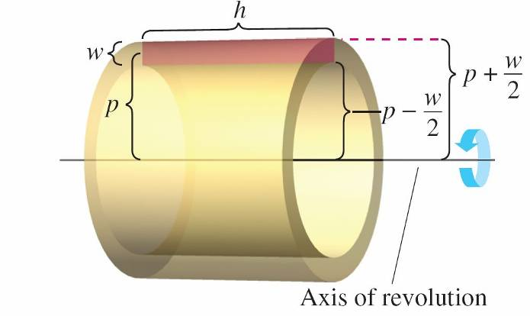
The Shell Method
An alternative method for finding the volume of a solid of revolution is called the shell method because it uses cylindrical shells.
A comparison of the advantages of the disk and shell methods is given later in this section.
Consider a representative rectangle as shown in
Figure 7.27, where w is the width
of the rectangle, h is the height of
the rectangle, and p is the distance
between the axis of revolution
and the center of the rectangle.
Figure 7.27

Slide 4
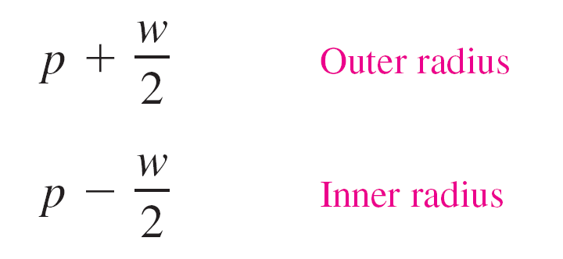
The Shell Method
When this rectangle is revolved about its axis of revolution, it forms a cylindrical shell (or tube) of thickness w.
To find the volume of this shell, consider two cylinders.
The radius of the larger cylinder corresponds to the outer radius of the shell, and the radius of the smaller cylinder corresponds to the inner radius of the shell. Because p is the average radius of the shell, you know the outer radius is p + (w/2) and the inner radius is p – (w/2).

Slide 5
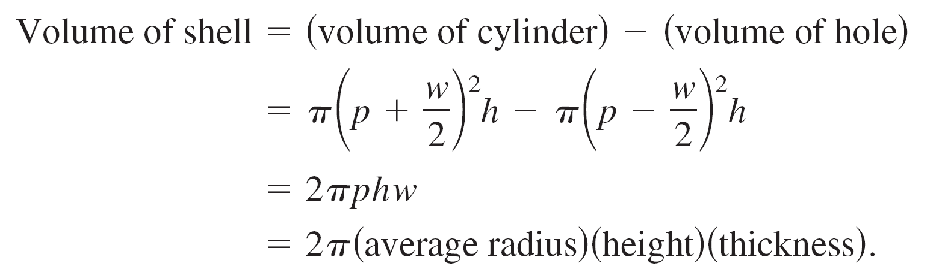
The Shell Method
So, the volume of the shell is
You can use this formula to find the volume of a solid of revolution.

Slide 6
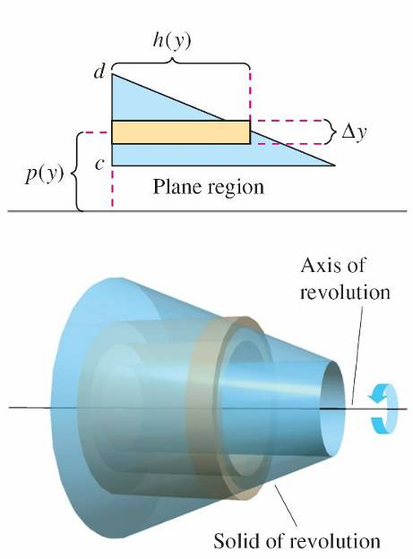
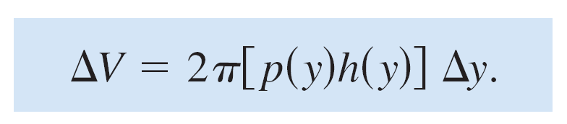
The Shell Method
Assume that the plane region in Figure 7.28 is revolved about a line to form the indicated solid.
If you consider a horizontal rectangle
of width ∆y, then, as the plane region
is revolved about a line parallel to the
x-axis, the rectangle generates a
representative shell whose volume is
Figure 7.28

Slide 7
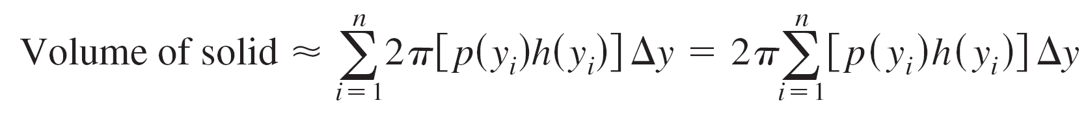

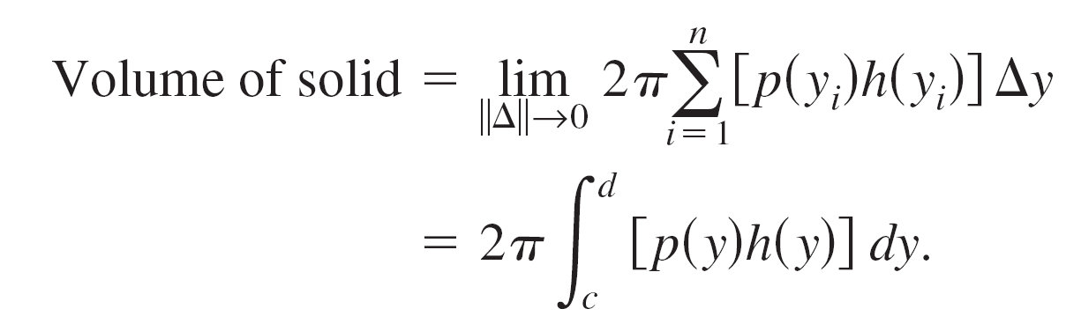
The Shell Method
You can approximate the volume of the solid by n such shells of thickness ∆y, height h(y_{i}), and average radius p(y_{i}).
This approximation appears to become better and better as ║∆║→ 0(n → ). So, the volume of the solid is

Slide 8
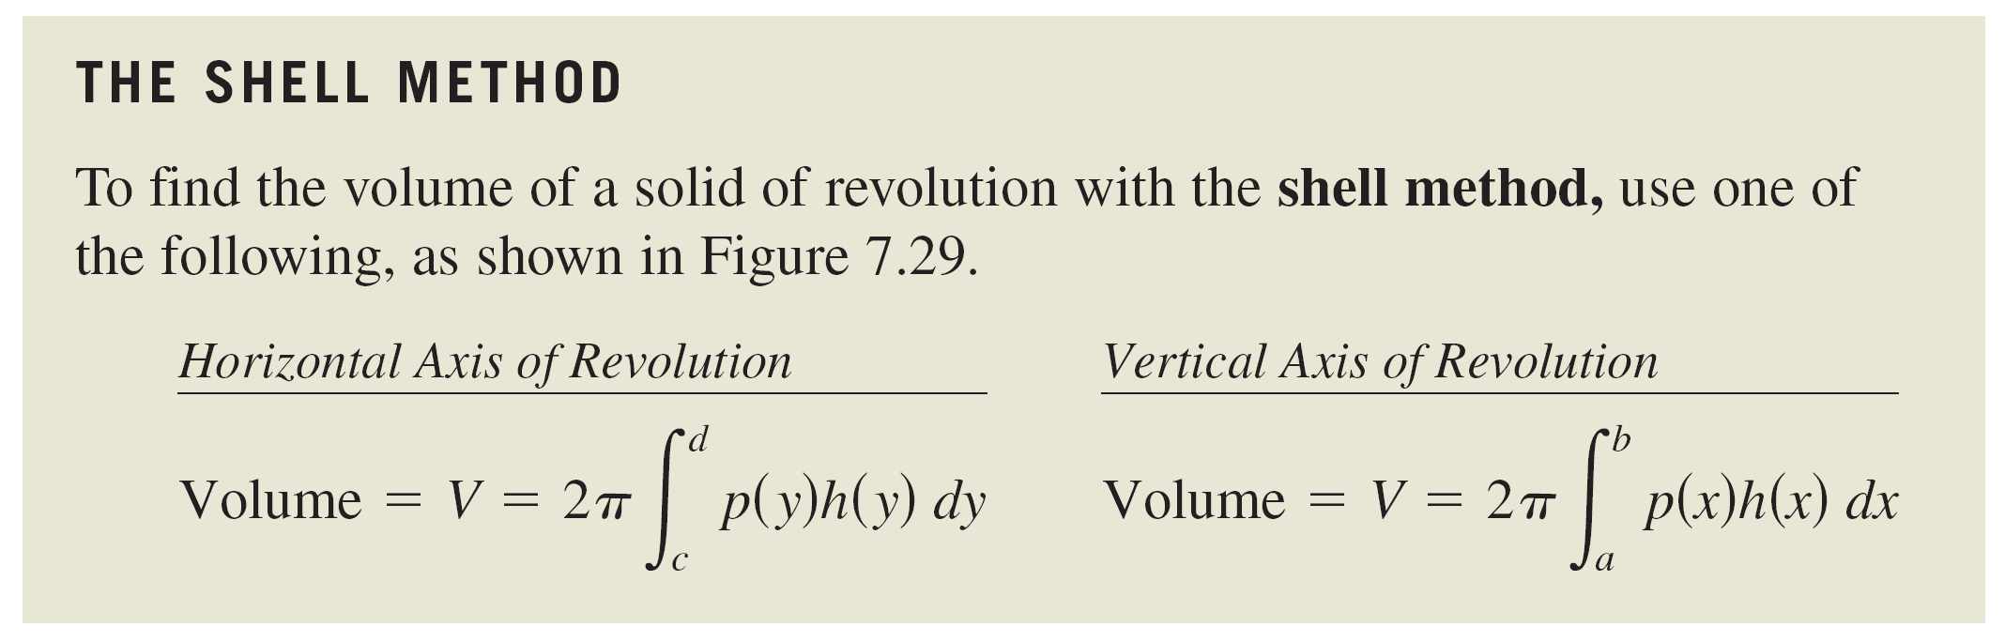
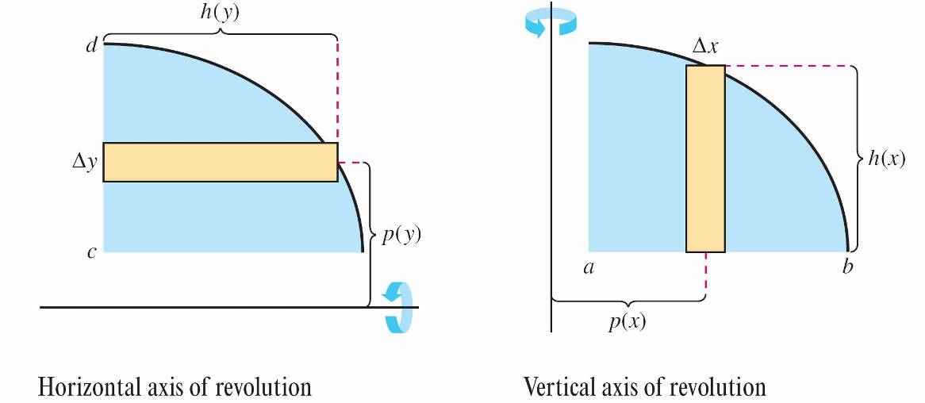
The Shell Method
Figure 7.29

Slide 9
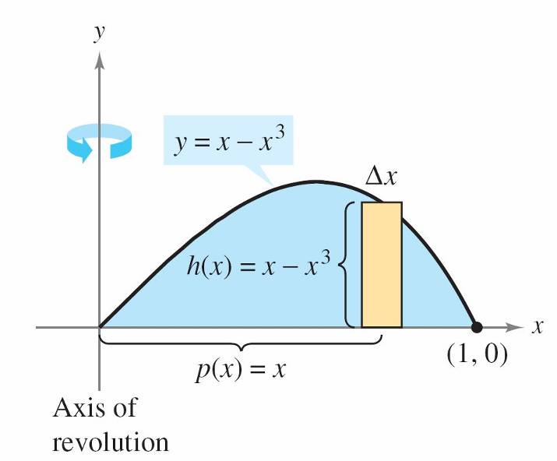
Example 1 – Using the Shell Method to Find Volume
Find the volume of the solid of revolution formed by revolving the region bounded by y = x – x³ and the x-axis (0 ≤ x ≤ 1) about the y-axis.
Solution:
Because the axis of revolution is
vertical, use a vertical representative
rectangle, as shown in Figure 7.30.
The width ∆x indicates that x is the
variable of integration.
Figure 7.30

Slide 10
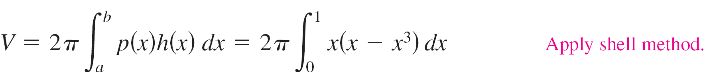
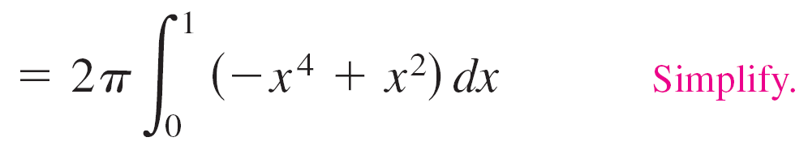
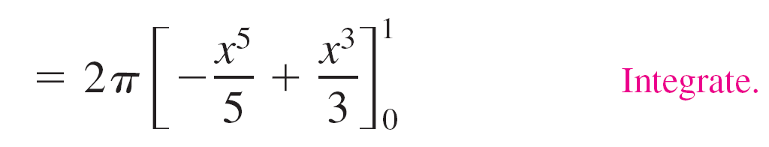
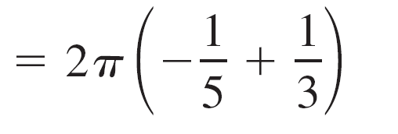
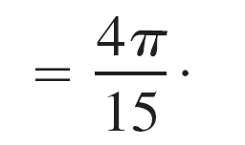
Example 1 – Solution
cont’d
The distance from the center of the rectangle to the axis of revolution is p(x) = x, and the height of the rectangle is
h(x) = x – x³.
Because x ranges from 0 to 1, the volume of the solid is

Slide 11
Comparison of Disk and Shell Methods

Slide 12
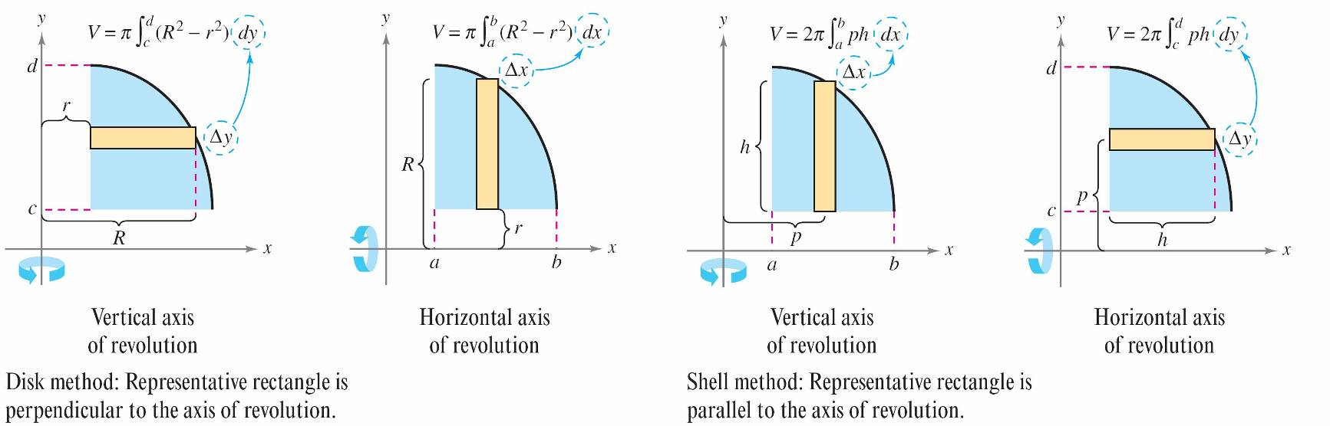
Comparison of Disk and Shell Methods
The disk and shell methods can be distinguished as follows.
For the disk method, the representative rectangle is always perpendicular to the axis of revolution, whereas for the shell method, the representative rectangle is always parallel to the axis of revolution, as shown in Figure 7.32.
Figure 7.32

Slide 13
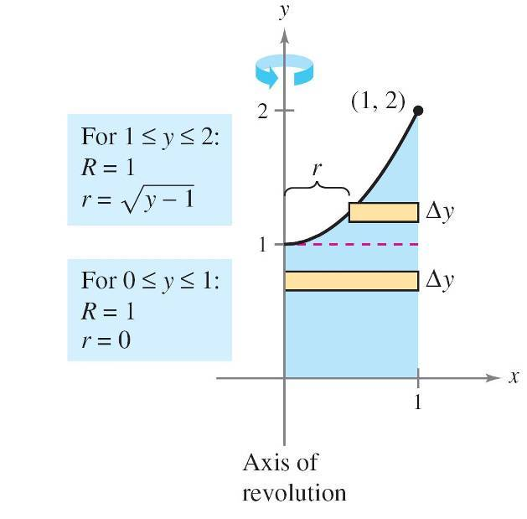

Example 3 – Shell Method Preferable
Find the volume of the solid formed by revolving the region bounded by the graphs of y = x² + 1, y = 0, x = 0, and x = 1
about the y-axis.
Solution:
The washer method requires two
integrals to determine the volume
of this solid. See Figure 7.33(a).
Figure 7.33(a)

Slide 14
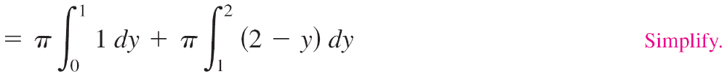
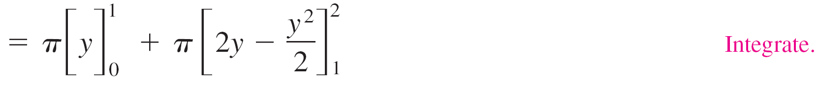
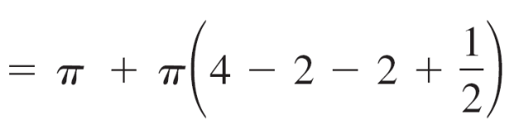
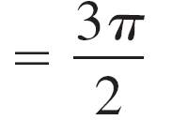
Example 3 – Solution
cont’d

Slide 15
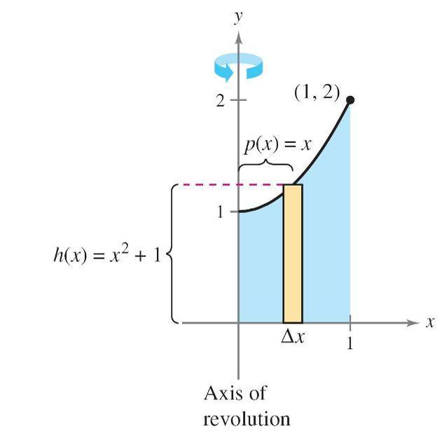
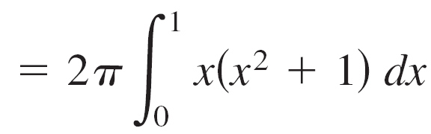
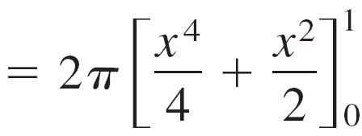

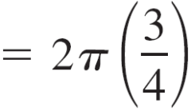

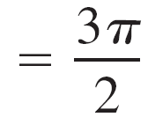
Example 3 – Solution
cont’d
In Figure 7.33(b), you can see that the shell method requires only one integral to find the volume.
Figure 7.33(b)

